Slide 1
Apache Ambari Overview
Nitiraj Rathore
Pallav Kulshreshtha
April 2017

Slide 2
Agenda
Background, Release History and Demo
Ambari Alerts and Metrics
Ambari Blueprints
Security Setup (Kerberos, RBAC)
Log Search
Automated Cluster Upgrade
Extensibility: Stacks and Views
What’s New and Next

Slide 3
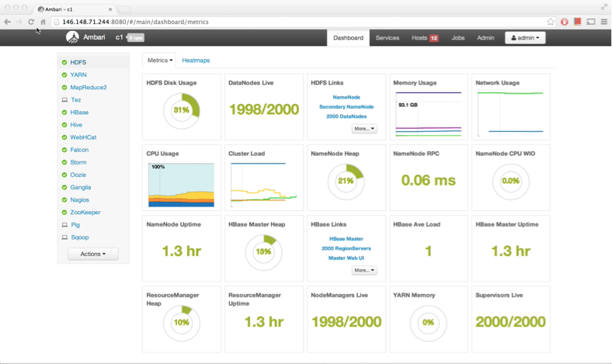
What is Apache Ambari?
A completely open source management platform for provisioning, managing, monitoring and securing Apache Hadoop clusters. Apache Ambari takes the guesswork out of operating Hadoop.

Slide 4
Ambari Recent Releases
Ambari 2.2.0
Dec 2015
Ambari 2.2.2
Apr 2016
Ambari 2.4.0 GA
Aug 2016
Ambari 2.5.0 GA
April 2017
Introduced Grafana
Introduced
Log Search TP
Introduced
Hive LLAP GA
Introduced Express Upgrade

Slide 5
Ambari Alerts

Slide 6
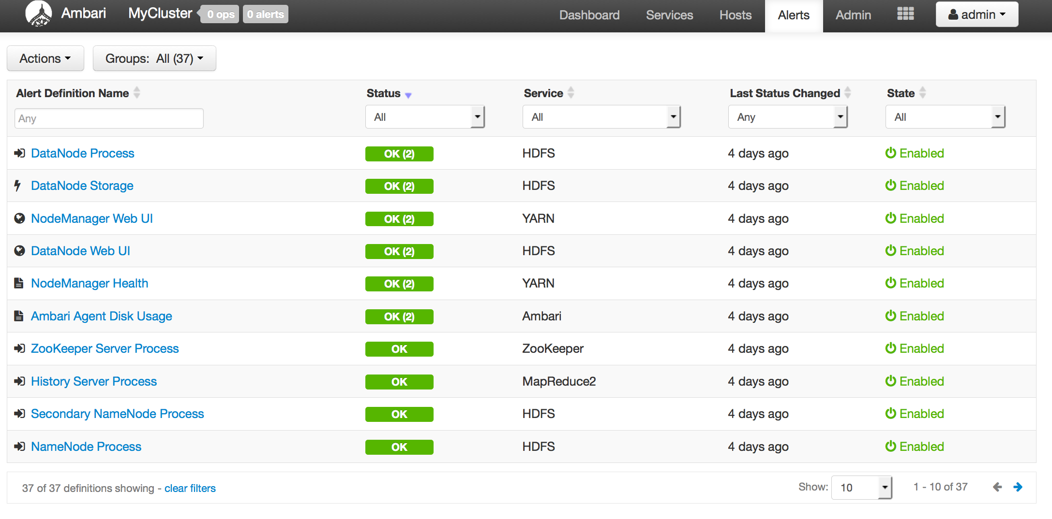
Full Visibility into Cluster Health
Centralized management of Health Alerts
Pre-defined alerts, configured by default on cluster install

Slide 7
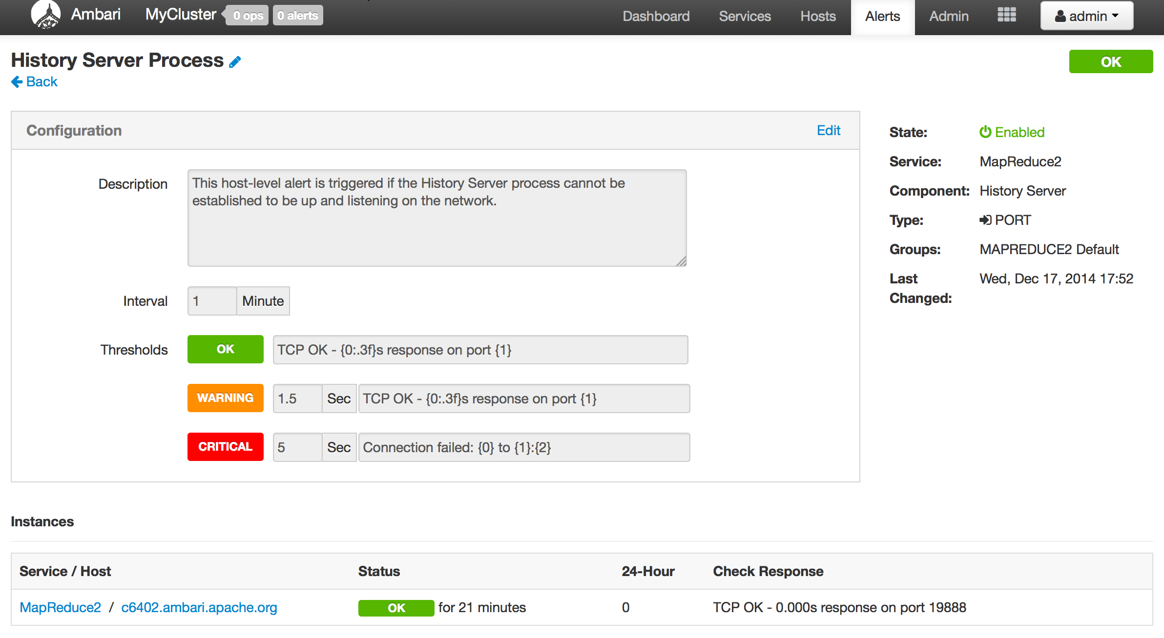
Customizing Alerts
Control thresholds, check intervals and response text

Slide 8
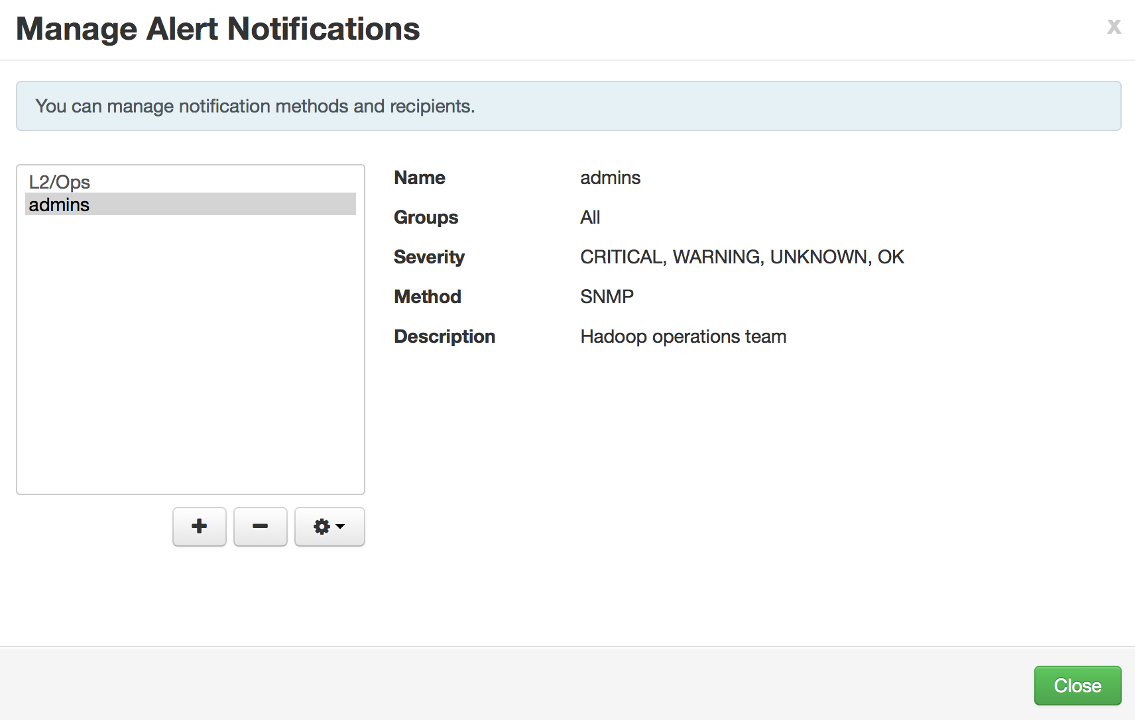
Alert Notifications
What: Create and manage multiple notification targets
Control who gets notified when
Why: Filter by severity
Send only certain notifications to certain targets based on severity
How: Control dispatch method
Support for EMAIL + SNMP

Slide 9
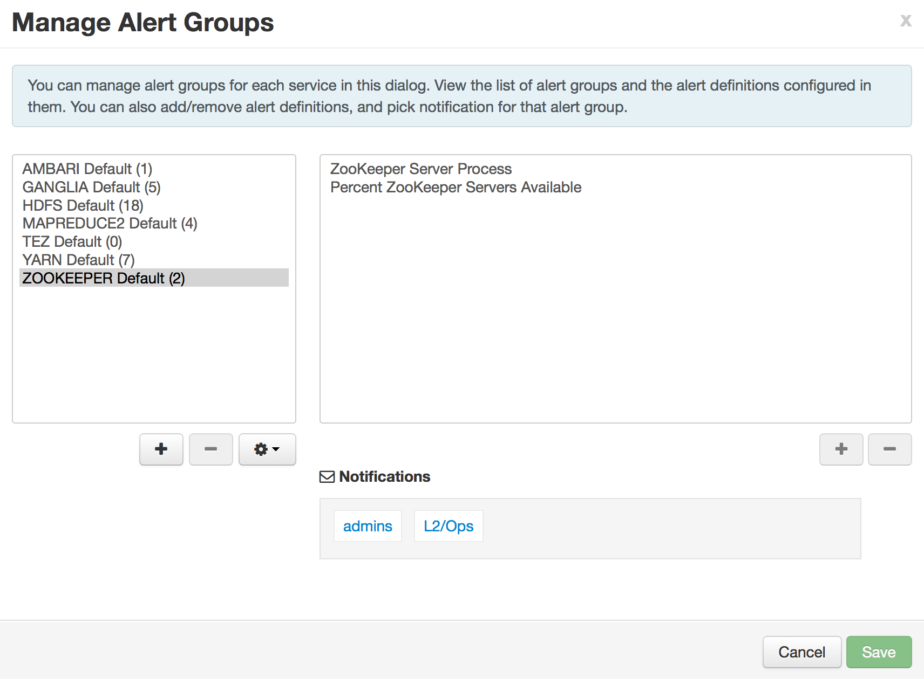
Alert Groups
Create and manage groups of alerts
Group alerts further controls what alerts are dispatched which notifications
Assign group to notifications
Only dispatch to interested parties

Slide 10
Alert Check Counts
Customize the number of times an alert is checked before dispatching a notification
Avoid dispatching an alert notification (email, snmp) in case of transient issues

Slide 11
Configuring the Check Count
Set globally for all alerts, or override for a specific alert
Global Setting
Alert Override

Slide 12
State Change Types
SOFT state changes do not perform a dispatch
HARD state changes (to non-OK) perform dispatch
Regardless of change:
The Ambari Web UI will show the current state (OK/WARN/CRIT)
The state change is written to ambari-alerts.log
2016-05-31 13:20:52,294 [CRITICAL] [SOFT] [AMBARI_METRICS] [grafana_webui] (Grafana Web UI) Connection failed to http://c6401.ambari.apache.org:3000 (<urlopen error [Errno 111] Connection refused>)
2016-05-31 13:22:52,290 [CRITICAL] [HARD] [AMBARI_METRICS] [grafana_webui] (Grafana Web UI) Connection failed to http://c6401.ambari.apache.org:3000 (<urlopen error [Errno 111] Connection refused>)
Note: check counts are not configurable for AGGREGATE alert types. All state changes are considered HARD.

Slide 13
Example: Check Count = 3
Check Interval
Check Interval
Check Interval
Check Interval
Check Interval
Check 1/3
State: OK
Change: n/a
Check 1/3
State: OK
Change: n/a
Check 1/3
State: CRIT
Change: SOFT
Check 2/3
State: CRIT
Change: n/a
Check 3/3
State: CRIT
Change: HARD
Check 1/3
State: OK
Change: HARD
DISPATCH
no state change
state changes to CRIT
performing multiple checks
back to OK

Slide 14
Other Items
Alerts Log (AMBARI-10249)
Alert state changes are written to /var/log/ambari-server/ambari-alerts.log
Script-based Alert Notifications (AMBARI-9919)
Define a custom script-based notification dispatcher
Executed on alert state changes
2015-07-13 14:58:03,744 [OK] [ZOOKEEPER] [zookeeper_server_process] (ZooKeeper Server Process) TCP OK - 0.000s response on port 2181
2015-07-13 14:58:03,768 [OK] [HDFS] [datanode_process_percent] (Percent DataNodes Available) affected: [0], total: [1]

Slide 15
Ambari Alerting System
User creates or modifies cluster
Ambari reads alert definitions from Stack
Ambari sends alert definitions to Agents and Agent schedules instance checks
Agents reports alert instance status in the heartbeat
Ambari responds to alert instance status changes and dispatches notifications (if applicable)
email
snmp
5
Ambari
Server
1
3
Ambari
Agent(s)
4
2
Stack definition
alerts.json

Slide 16
Alert REST APIs
REST Endpoint | Description
/api/v1/clusters/:clusterName/alert_definitions | The list of alert definitions for the cluster.
/api/v1/clusters/:clusterName/alerts | The list of alert instances for the cluster. Use partial response syntax to filter. Example: find all alert instances that are CRITITAL /api/v1/clusters/c1/alerts?Alert/state.in(CRITICAL) Example: find all alert instances for “ZooKeeper Process” alert def /api/v1/clusters/c1/alerts?Alert/definition_name=zookeeper_server_process
/api/v1/clusters/:clusterName/alert_groups | The list of alert groups.
/api/v1/clusters/:clusterName/alert_history | The list of alert instance status changes.
/api/v1/alert_targets/ | The list of configured alert notification targets for Ambari.

Slide 17
Ambari Metrics

Slide 18
Ambari Metrics
Built using Hadoop technologies
Three components: Metrics Collector, Metrics Monitors, Grafana
Phoenix
ATS
HBase
Local Filesystem or HDFS

Slide 19
Metrics Collection
Metric Monitors send system-level metrics to Collector
Sinks send Hadoop-level metrics to Collector
Metrics Collector service stores and aggregates metrics
Ambari exposes REST API for metrics retrieval
Ambari
Server
Metrics Collector
4
3
1
2
Metrics Monitor
Sink(s)
Metrics Monitor
Sink(s)
Metrics Monitor
Sink(s)
Host1
Host1
Hosts

Slide 20
Ambari Metrics + Grafana: Introduced with Ambari 2.2
Highlights
List of Dashboards
Including Grafana as a “Native UI” for Ambari Metrics
Including pre-build Dashboards
Supports configuring for HTTPS
System Home, Servers
HDFS Home, NameNodes, DataNodes
YARN Home, Applications, Job History Server
HBase Home, Performance, Misc

Slide 21
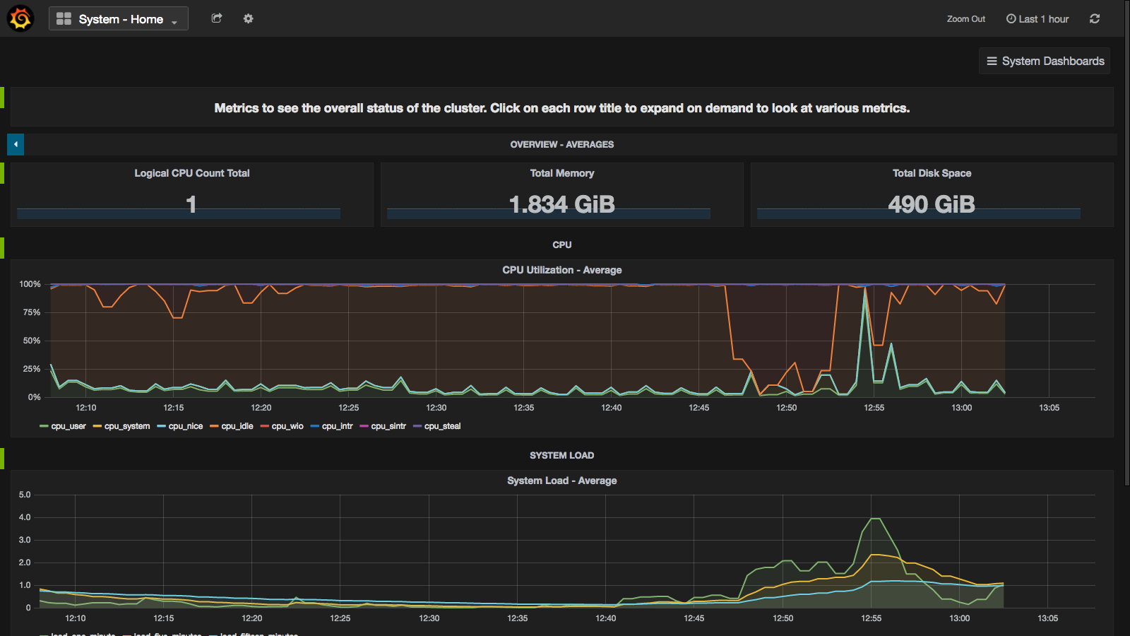
Grafana includes pre-built dashboards for visualizing the most important cluster metrics.

Slide 22
Ambari Blueprints

Slide 23
Before Ambari
Manual Installation
Manual configuration
Manual distribution of configuration
XML
XML
XML

Slide 24
Ambari Blueprints
Two primary goals of Ambari Blueprints:
Provide API-driven deployments based on self-contained cluster description
Ability to export a complete cluster description of a running cluster
Blueprints contain cluster topology and configuration information
Enables interesting use cases between physical and virtual environments

Slide 25
Ambari Stacks + Blueprints Together
Stack Definition
Component Layout & Configuration
BLUEPRINT
BLUEPRINT
HOSTS
CLUSTER
INSTANTIATE

Slide 26
Blueprints API
BLUEPRINT
1
POST /blueprints/my-blueprint
CLUSTER
CREATION
TEMPLATE
2
POST /clusters/MyCluster

Slide 27
Example: Single-Node Cluster
BLUEPRINT
Description
Single-node cluster
Use HDP 2.2 Stack
HDFS + YARN + MR2
Everything on c6401
{
"configurations" : [
{
”hdfs-site" : {
"dfs.namenode.name.dir" : ”/hadoop/nn"
}
}
],
"host_groups" : [
{
"name" : ”uber-host",
"components" : [
{ "name" : "NAMENODE” },
{ "name" : "SECONDARY_NAMENODE” },
{ "name" : "DATANODE” },
{ "name" : "HDFS_CLIENT” },
{ "name" : "RESOURCEMANAGER” },
{ "name" : "NODEMANAGER” },
{ "name" : "YARN_CLIENT” },
{ "name" : "HISTORYSERVER” },
{ "name" : "MAPREDUCE2_CLIENT” }
],
"cardinality" : "1"
}
],
"Blueprints" : {
"blueprint_name" : "single-node-hdfs-yarn",
"stack_name" : "HDP",
"stack_version" : "2.2"
}
}
CLUSTER CREATION TEMPLATE
{
"blueprint" : "single-node-hdfs-yarn",
"host_groups" :[
{
"name" : ”uber-host",
"hosts" : [
{
"fqdn" : "c6401.ambari.apache.org”
}
]
}
]
}

Slide 28
Blueprints Add Host
POST /api/v1/clusters/MyCluster/hosts
{
"blueprint" : "myblueprint",
"host_group" : "workers",
"host_name" : "c6403.ambari.apache.org"
}
Add hosts to a cluster based on a host group from a Blueprint
Add one or more hosts with a single call
POST /api/v1/clusters/MyCluster/hosts
[
{
"blueprint" : "myblueprint",
"host_group" : "workers",
"host_name" : "c6403.ambari.apache.org"
},
{
"blueprint" : "myblueprint",
"host_group" : ”edge",
"host_name" : "c6404.ambari.apache.org"
}
]
https://issues.apache.org/jira/browse/AMBARI-8458

Slide 29

Blueprints Host Discovery (AMBARI-10750)
POST /api/v1/clusters/MyCluster/hosts
[
{
"blueprint" : "single-node-hdfs-test2",
"host_groups" :[
{
"host_group" : "slave",
"host_count" : 3,
"host_predicate" : "Hosts/cpu_count>1”
}
]
}
]
Ambari
Notes:
Dynamic availablity

Slide 30
Where Can I Learn More About Blueprints?
https://cwiki.apache.org/confluence/display/AMBARI/Blueprints

Slide 31
Kerberos Setup

Slide 32
Background: Hadoop + Kerberos
Strongly authenticating and establishing a user’s identity is the basis for secure access in Hadoop. Users need to be able to reliably “identify” themselves and then have that identity propagated throughout the Hadoop cluster.
Once this is done, those users can access resources (such as files or directories) or interact with the cluster (like running MapReduce jobs).
Besides users, Hadoop cluster resources themselves (such as Hosts and Services) need to authenticate with each other to avoid potential malicious systems or daemon’s “posing as” trusted components of the cluster to gain access to data.

Slide 33
Background: Hadoop + Kerberos
Hadoop Cluster
Kerberos is used to secure the Components in the cluster. Kerberos identities are managed via “keytabs” on the Component hosts.
Service Component A
Service Component B
Service Component C
Service Component D
keytab
keytab
keytab
keytab
Principals for the cluster are managed in the KDC.
Service Component X
Service Component X
Service Component X
Service Component X
KDC
keytab
keytab
keytab
keytab

Slide 34
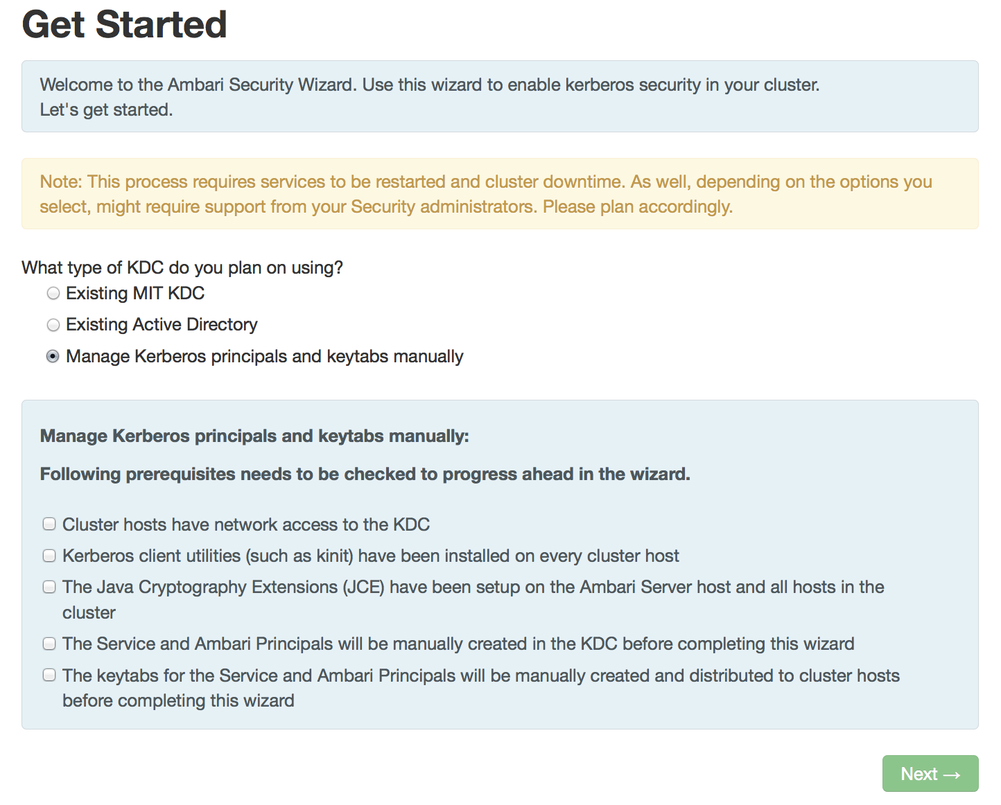
Automated Kerberos Security Setup
Wizard Driven Simplify the experience of enabling and managing Kerberos security
Automated and Manual Options Critical for today’s enterprise
Works with Existing Kerberos Infrastructure Such as Active Directory and MIT KDC

Slide 35
Automated vs. Manual Kerberos Options
 | Automated | Manual
KDC Infrastructure | MIT, Active Directory | MIT, Active Directory, FreeIPA
Requires KDC administrative credentials | Yes | No
Installation of Kerberos clients | Yes, optional | No
Management of Kerberos client krb5.conf | Yes, optional | No
Creation of principals | Yes | No
Creation of keytabs | Yes | No
Distribution of keytabs | Yes | No
Cluster configuration | Yes | Yes

Slide 36
Automated: Principals and Keytabs
User provides KDC Admin Account credentials to Ambari
Ambari connects to KDC, creates principals (Service and Ambari) needed for cluster
Ambari generates keytabs for the principals
Ambari distributes keytabs to Ambari Server and cluster hosts
Ambari discards the KDC Admin Account credentials
Ambari
Server
KDC
1
2
3
5
4
Cluster

Slide 37
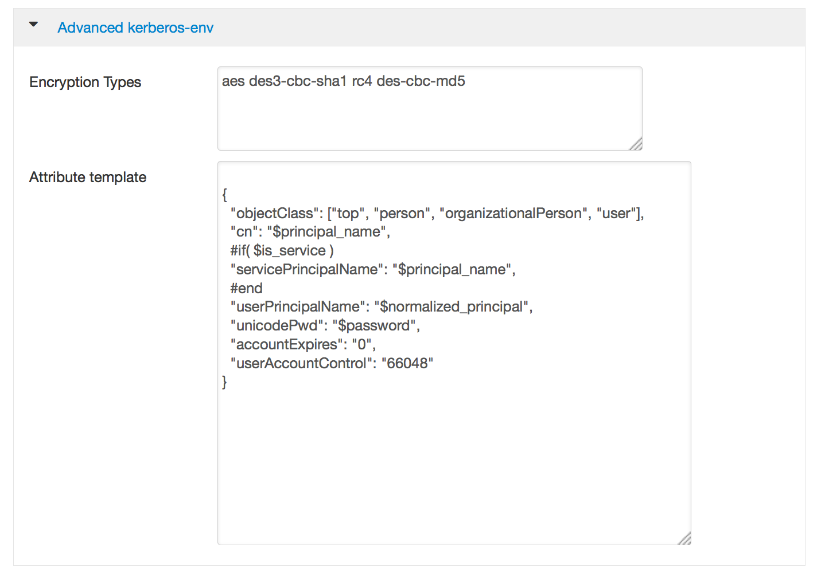
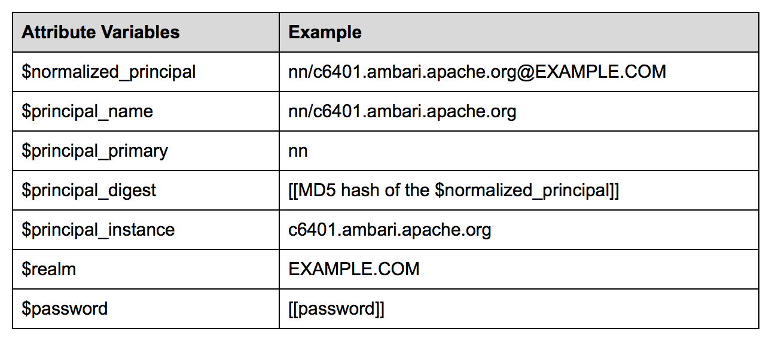
Automated: Customizable Principal Attributes
Customize the directory principal attributes for your environment
Particularly useful when using Active Directory for Kerberos

Slide 38
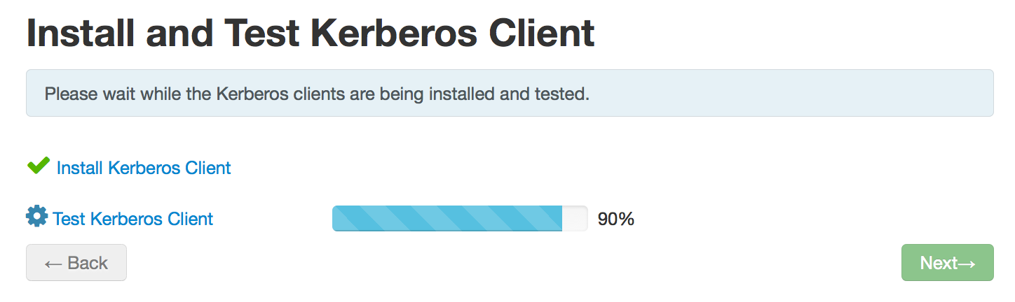
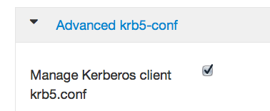
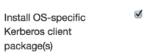
Automated: Kerberos Clients
Option to manage krb5.conf
Option to install clients
OS | Client
RHEL/CentOS/OEL | krb5-workstation
SLES 11 | krb5-client
Ubuntu 12 | krb5-user, krb5-config

Slide 39
Automated: Kerberos Operations
Once enabled, Ambari works directly with the Kerberos infrastructure to automate these common tasks, removing the burden from the operator:
Add/Delete Host
Add Service
Add/Delete Component
Regenerate Keytabs
Disable Kerberos

Slide 40
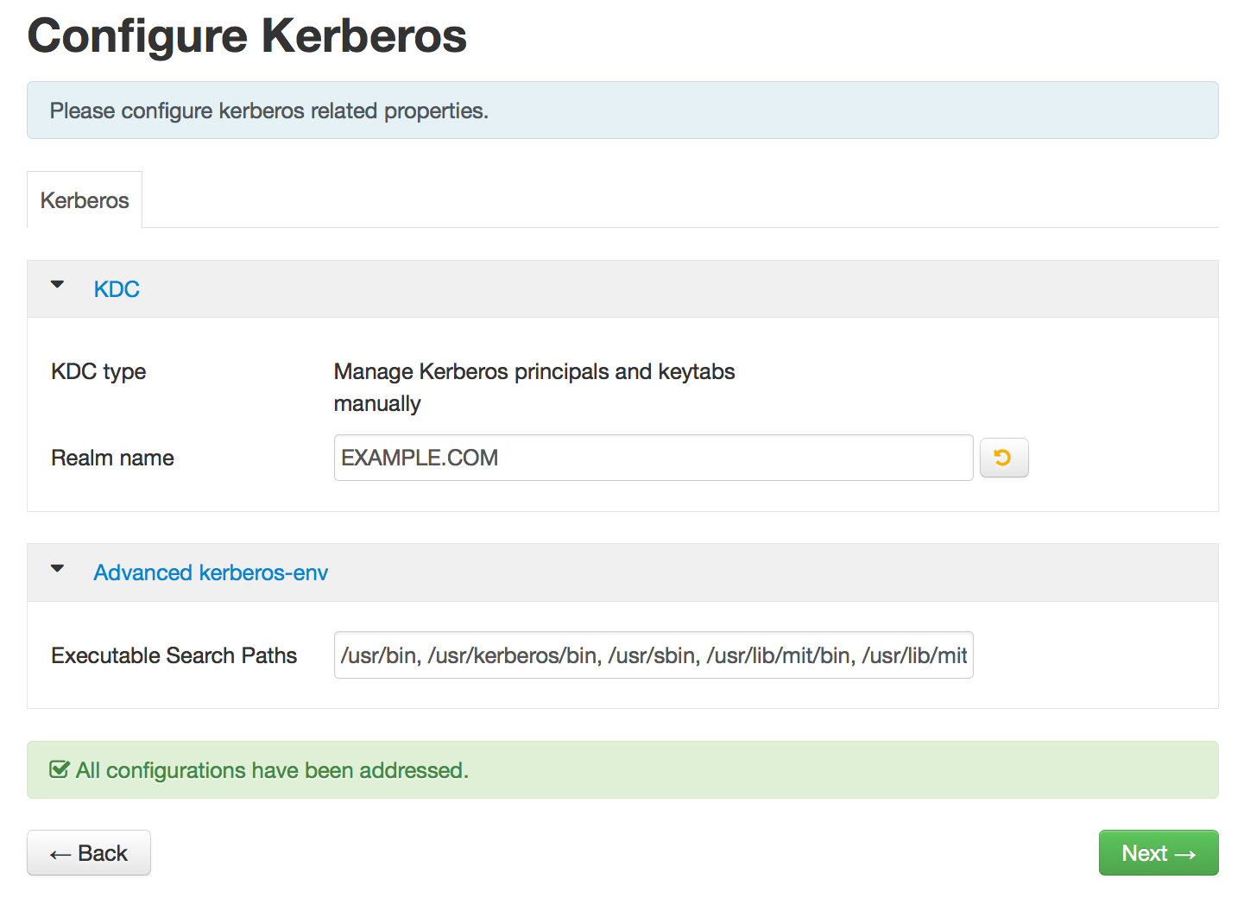
Manual: Specify Realm, Client Utilities Path

Slide 41
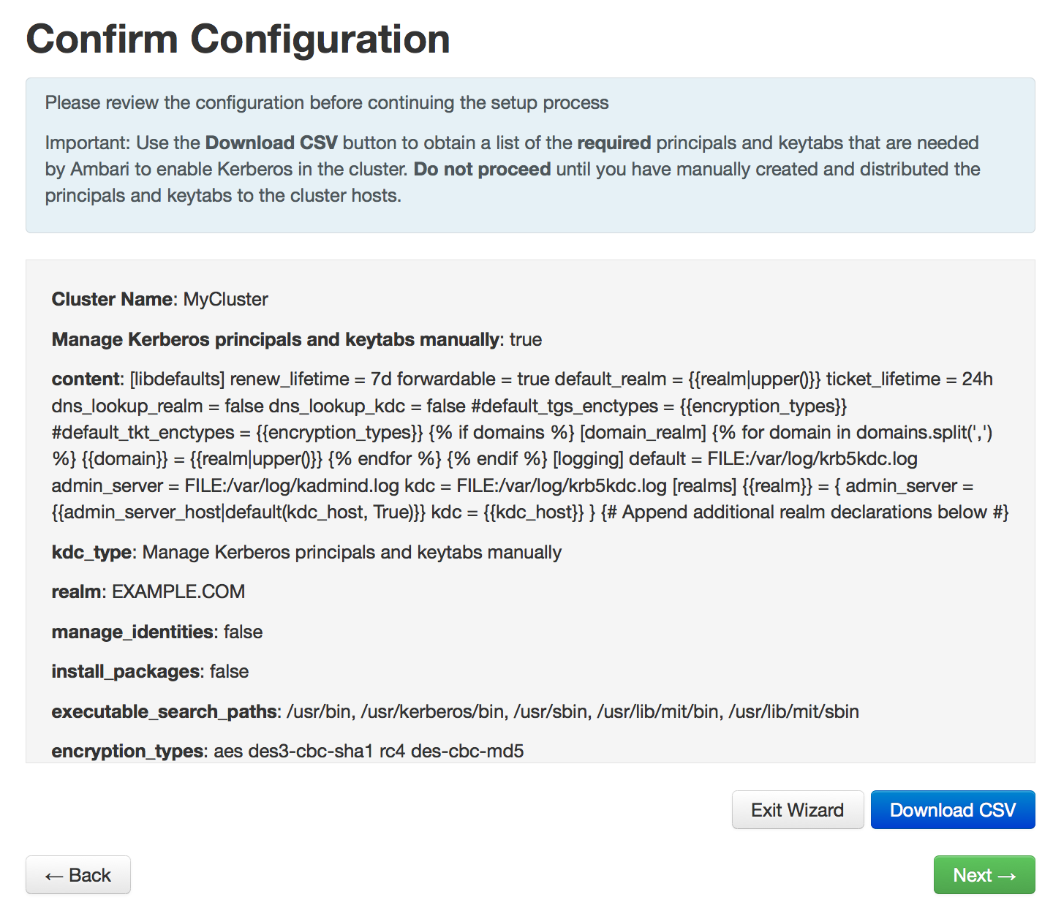
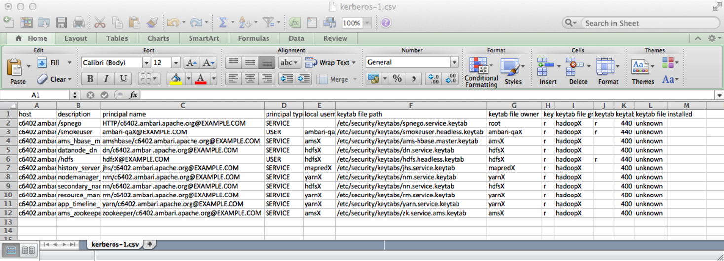
Manual: Principals and Keytabs
Configure Identities
Download CSV

Slide 42
Role-Based Access Control (RBAC)

Slide 43
Role-Based Access Control
Use “roles” for more granular division of control for cluster operations
Old Permission | New Role | Notable Permissions
Operator | Cluster Administrator | Full operational control, including upgrades. Ambari Admins are implicitly granted this Role.
 | Cluster Operator | Adding and removing hosts.
 | Service Administrator | Manage configurations, move components.
 | Service Operator | Service stop and start and service-specific operations such as HDFS Rebalance.
Read-Only | Cluster User | View cluster service and host information.
Note: Users flagged as “Ambari Admins” are implicitly granted Cluster Administrator permission.

Slide 44
Managing Cluster Roles
Assign roles to users or groups
Manage roles in Block or List View layouts

Slide 45
Managing Cluster Roles
View users or groups
Change current role assignment

Slide 46
Log Search
TECH PREVIEW

Slide 47
Log Search
Tech Preview
Search cluster Component Logs from within Ambari!
Goal: When issues arise, be able to quickly find issues across all cluster components
Capabilities
Rapid Search of all cluster component logs
Search across time ranges, log levels, and for keywords
Core Technologies:
Apache Ambari
Apache Solr
Apache Ambari Log Search
Log Search
Ambari
Solr

Slide 48

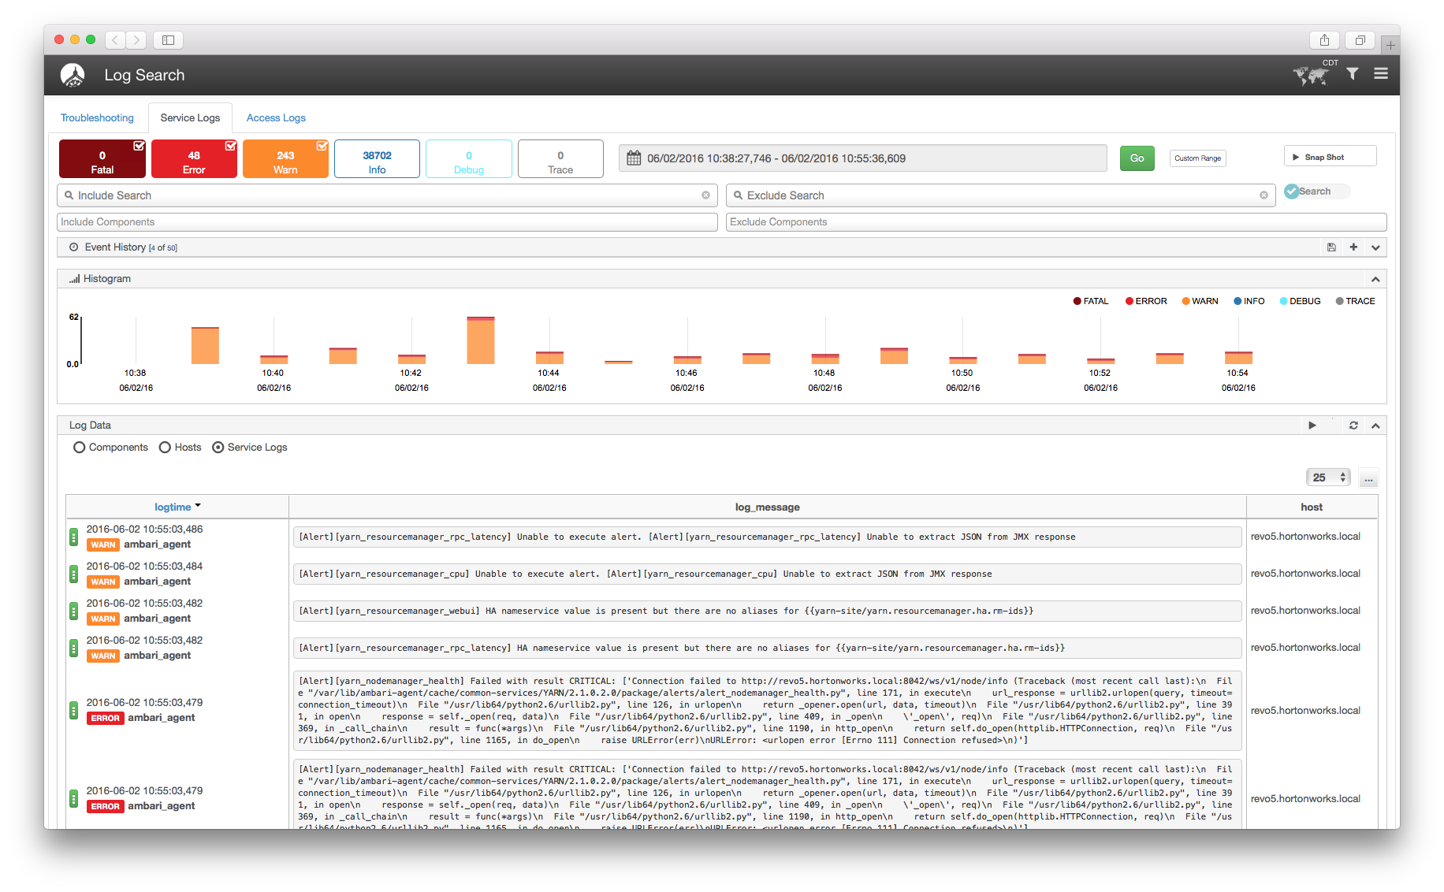
Log Search Architecture
Tech Preview
Log
Feeder
Log
Feeder
Log
Feeder
Ambari
Worker
Node
Worker
Node
Worker
Node
Log
Search
UI
Solr
Log
Feeder
Log
Feeder
Log
Feeder
Worker
Node
Worker
Node
Worker
Node

Slide 49
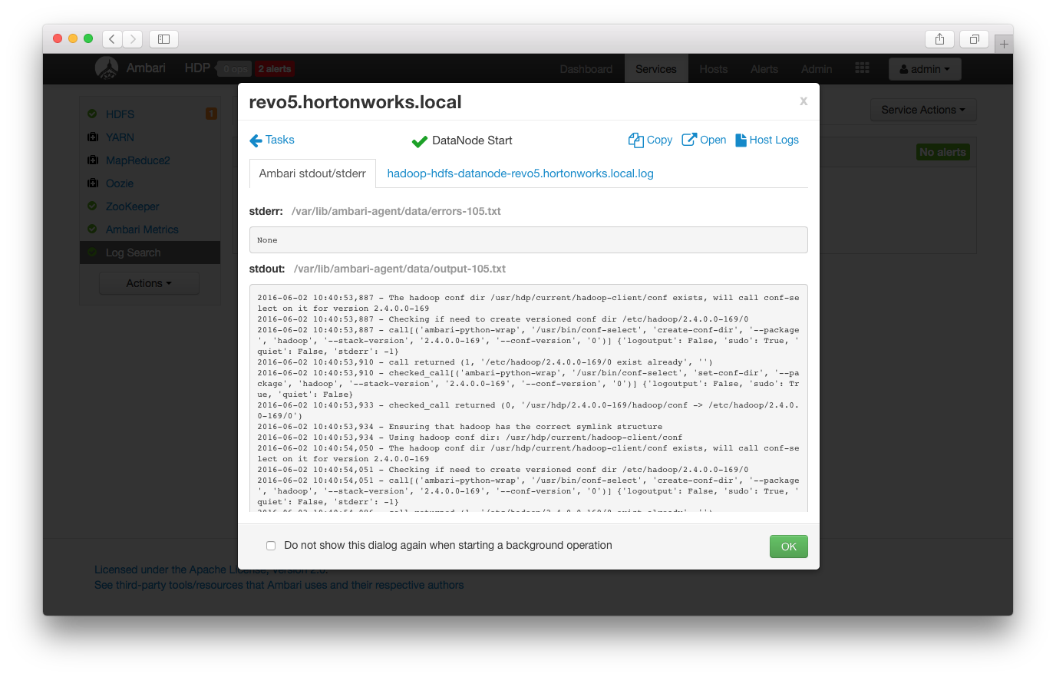
Log Search Details
Tech Preview
Java Process
Multi-output Support
Grok
Log
Feeder
Worker
Node
Ambari
Solr Cloud
Local Disk Storage
TTL
Log
Search
UI
Solr
Solr
Solr

Slide 50
Automated Cluster Upgrade

Slide 51
Automated Cluster Upgrade Terminology
Rolling Upgrade
Orchestrates the cluster upgrade in an order that is meant to preserve cluster operation and minimize service impact. The tradeoff is more stringent prerequisites and a longer upgrade time.
Express Upgrade
Orchestrates the cluster upgrade in an order that will incur cluster downtime. This method has less stringent prerequisites but completes in a faster upgrade time.

Slide 52
Automated Upgrade: Rolling or Express Choice
Check Prerequisites
Prepare
Register + Install
Perform Upgrade
Finalize
Review the prerequisites to confirm your cluster configuration is ready for upgrade
Perform the preparation steps, which include making backups of critical cluster metadata.
Register the software repository and install the target version on the cluster.
Perform the upgrade. The steps depend on upgrade method: Rolling or Express.
Finalize the upgrade, making the target version the current version.

Slide 53
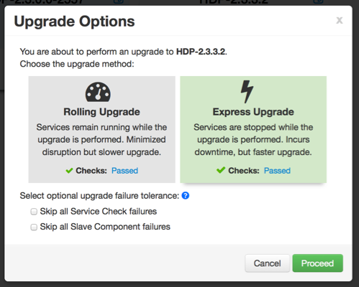
Automated Upgrade Choice: Rolling or Express

Slide 54
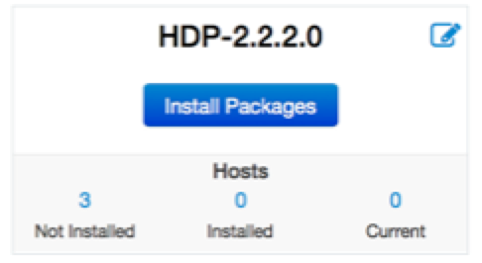
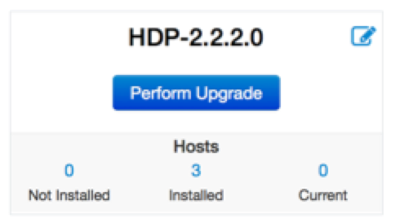
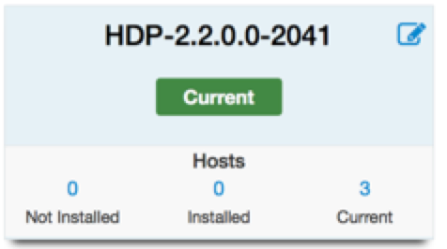
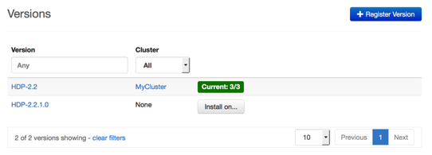
Automated Upgrade: High-Level Process
Register
Install
Perform
Upgrade
Finalize

Slide 55
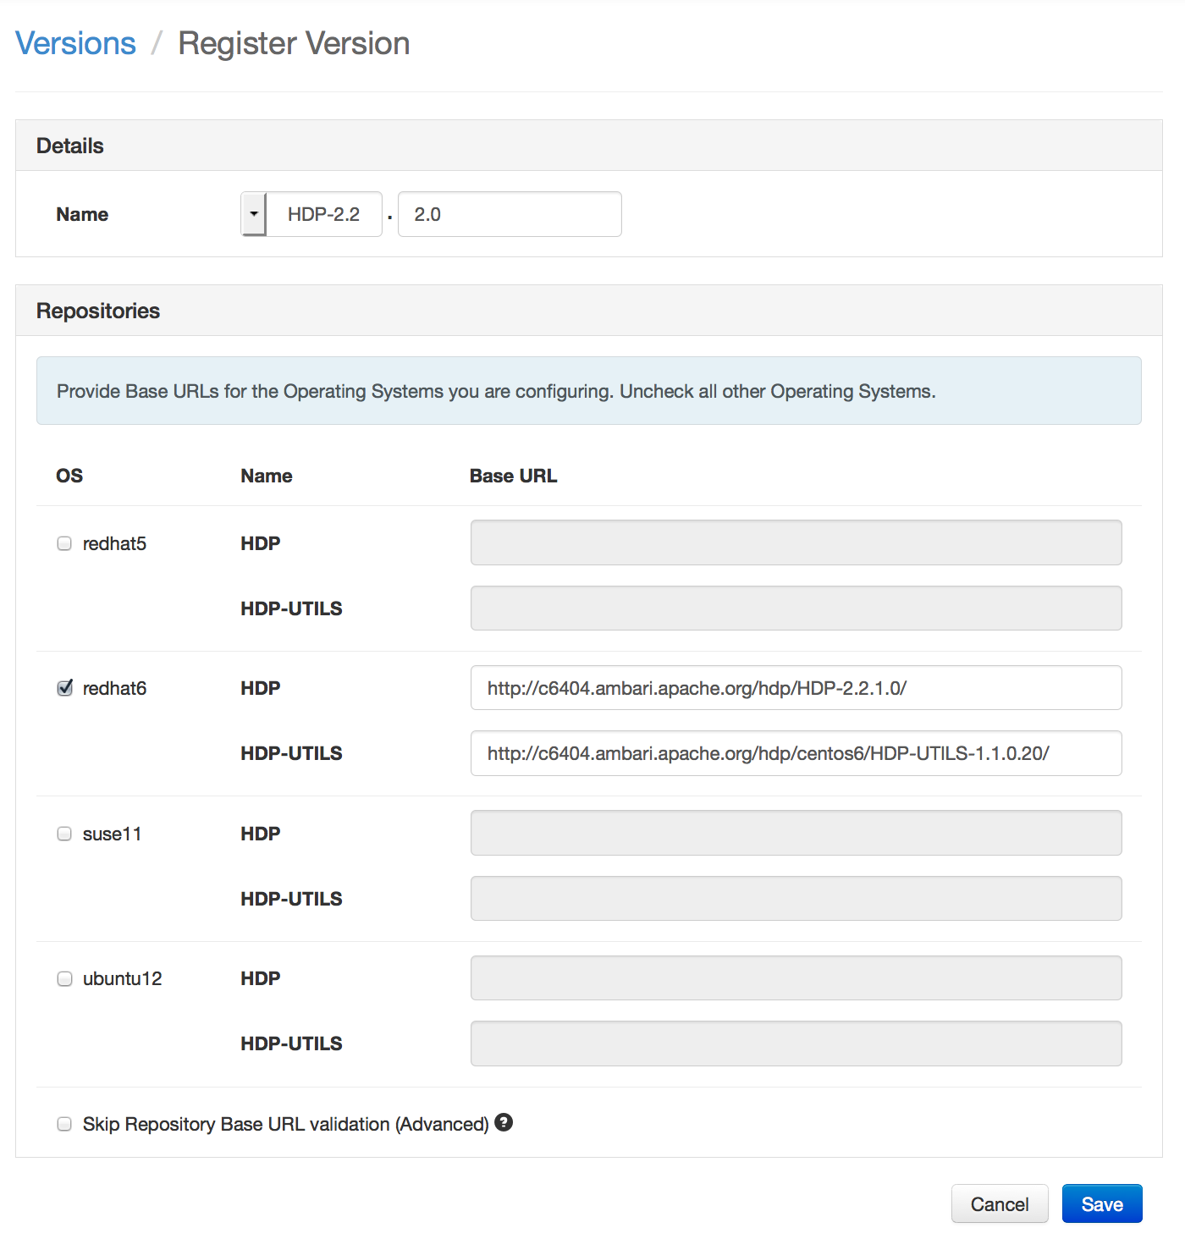
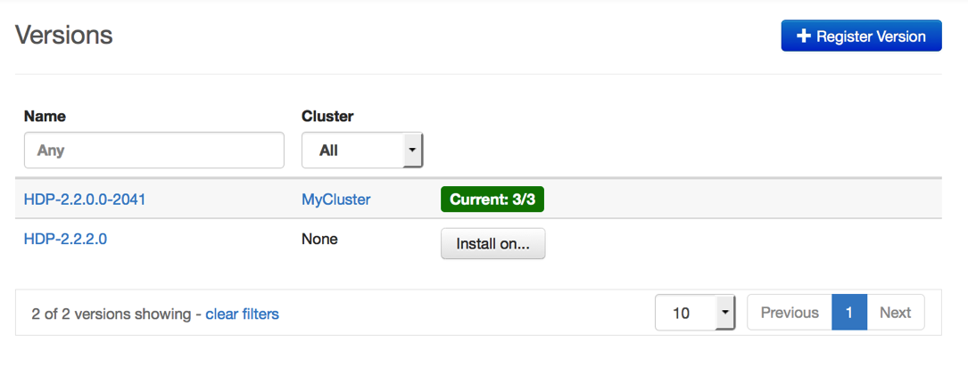


Register New Version
Register
Install
Perform
Upgrade
Finalize
Register new version with Ambari
Provide the Repository Base URLs for new version

Slide 56
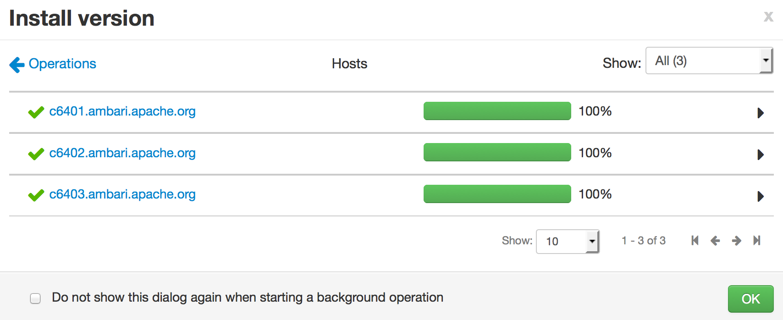
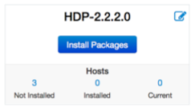
Install Packages
Register
Install
Perform
Upgrade
Finalize
Click “Install Packages” to start the install of the version across hosts

Slide 57
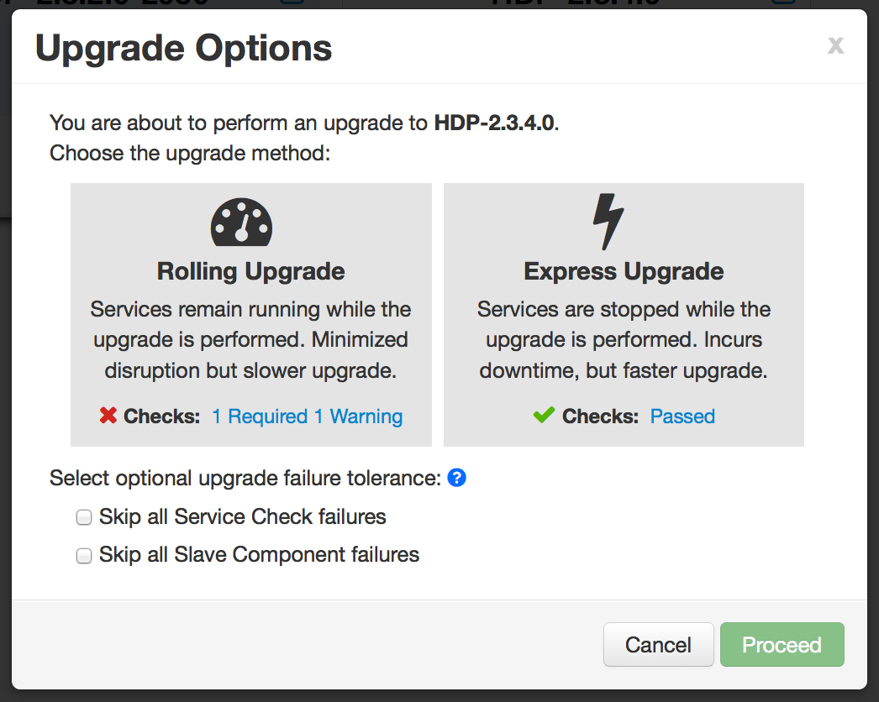
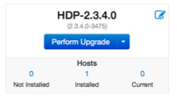
Upgrade Choice
Register
Install
Perform
Upgrade
Finalize
Upgrade Options dialog gives you a choice of method: Rolling or Express

Slide 58
Upgrade Choice: Rolling or Express
Register
Install
Perform
Upgrade
Finalize
Checks indicate if an option is available

Slide 59
Upgrade Choice: Rolling or Express
Register
Install
Perform
Upgrade
Finalize
New options to handle failures

Slide 60
Upgrade Tolerance Options
Register
Install
Perform
Upgrade
Finalize
Tolerance Option | Description
Skip all Service Check failures | Ambari will automatically skip any Service Check failures and complete the task without requiring user intervention to continue. After all the Service Checks have run in a task, you will be presented with summary of the failures and an option to continue the upgrade or pause.
Skip all Slave Component failures | Ambari will automatically skip any Slave Component failures and complete the task of upgrading Slave components without requiring user intervention to continue. After all Slave Components have been upgraded, you will be presented with a summary of the failures and an option to continue the upgrade or pause.

Slide 61
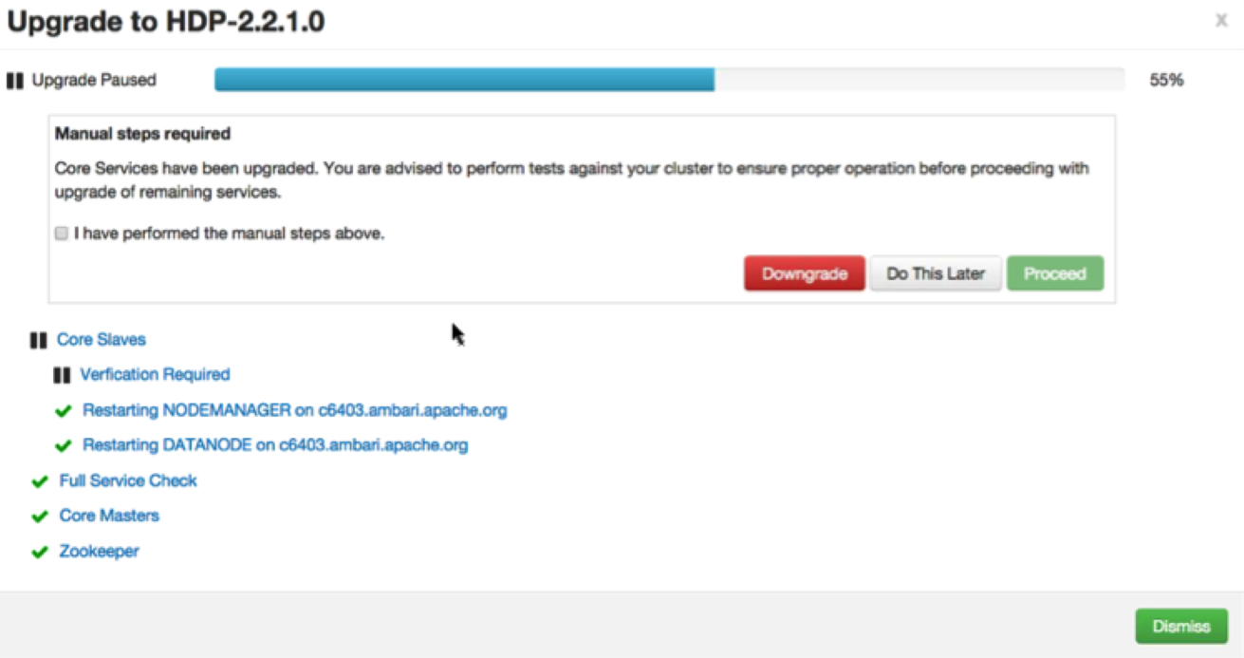
Wizard Driven Experience
Register
Install
Perform
Upgrade
Finalize
With verification and validation

Slide 62
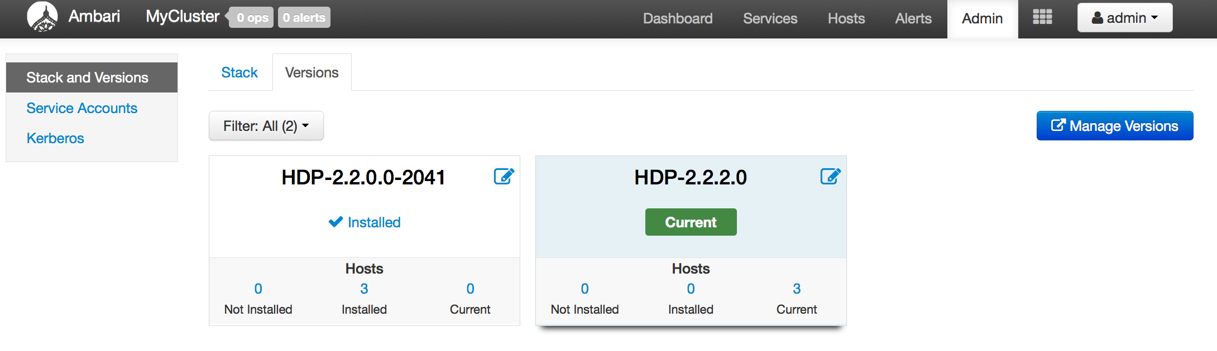
Rolling Upgrade – Success!
Register
Install
Perform
Upgrade
Finalize

Slide 63
Ambari Extensibility

Slide 64
Extensibility Features
Stacks
To add new Services (ISV or otherwise) beyond Stack
To customize a Stack for customer specific environments
Views
To extend and customize the Ambari Web UI
Add new capabilities, customize existing capabilities

Slide 65
Anatomy of Ambari Extension Points
Ambari
Web
Ambari
Server
Ambari
Agent
Ambari
Agent
Ambari
Agent
Stacks
js
java
Stacks
python
Stacks
Ambari Views
Ambari Stacks

Slide 66
Ambari Stacks

Slide 67

Ambari Stacks
Defines a consistent Stack lifecycle interface that can be extended
Encapsulates Stack Versions, Services, Components, Dependencies, Cardinality, Configurations, Commands
Dynamically add Stack + Service definitions
AMBARI
{rest}
HDFS
YARN
MR2
Stacks
Hive
HBase
Oozie
<ambari-web>
Falcon
Pig
Storm

Slide 68
Stack Terminology
Term | Definition | Examples
STACK | Defines a set of Services, where to obtain the software packages and how to manage the lifecycle. | HDP-2.5, HDP-2.6
SERVICE | Defines the Components that make-up the Service. | HDFS, YARN, HIVE, SPARK
COMPONENT | The building-blocks of a Service, that adhere to a certain lifecycle. | NAMENODE, DATANODE, OOZIE_SERVER
CATEGORY | The category of Component. | MASTER, SLAVE, CLIENT

Slide 69
Stack Mechanics
Stacks define Services + Repos
What is in the Stack, and where to get the bits
Each Service has a definition
What Components are part of the Service
Each Service has defined lifecycle commands
start, stop, status, install, configure
Lifecycle is controlled via command scripts
Ability to define “custom” commands
AMBARI
SERVER
Repos
AMBARI
AGENT/S
Stack
AMBARI
AGENT/S
AMBARI
AGENT/S
Service Definitions
Command Scripts
xml
python

Slide 70
Stacks Support Inheritance
HDP 2.6 Stack
LLAP, Hive View 2.0, Visual explain of Hive query
HDP 2.4 Stack
Overrides any Service definitions, commands and configurations
Adds new Services specific to this Stack
HDP 2.0 Stack
Defines a set of Service definitions
Default service configurations and command scripts

Slide 71
Where Can I Learn More About Stacks?
https://cwiki.apache.org/confluence/pages/viewpage.action?pageId=38571133
https://github.com/apache/ambari/tree/trunk/ambari-server/src/main/resources/stacks/HDP/

Slide 72
Guided Configs

Slide 73
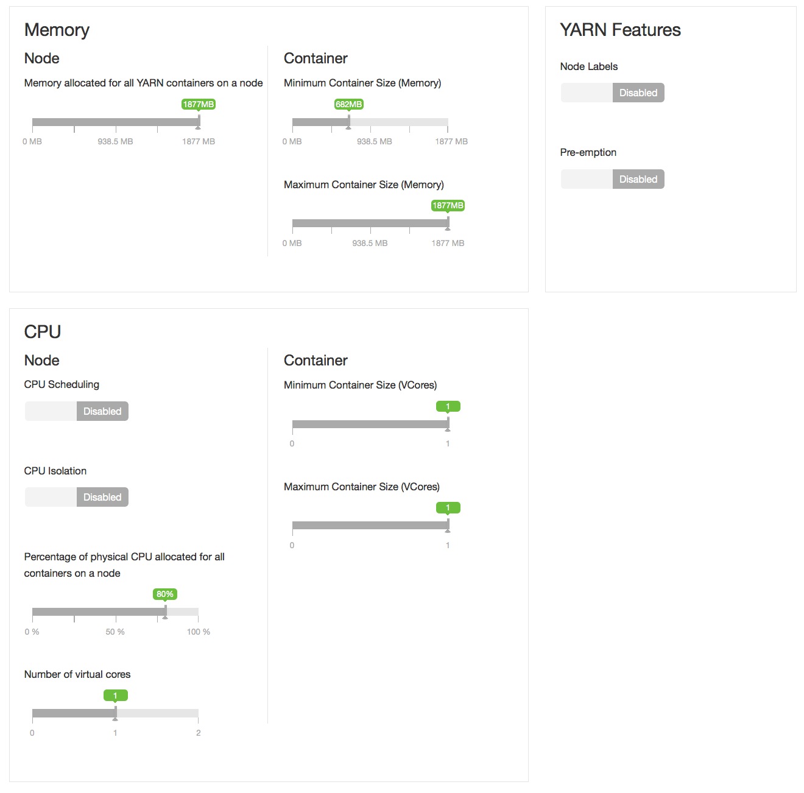
Guided Configurations
Take the guesswork out of cluster configuration
Intuitive layout and grouping of configurations
Smart UI controls to make it easier to set values
Recommendations and cross-service dependency checks
Take the guesswork out of cluster configuration
Driven by Stack definition

Slide 74
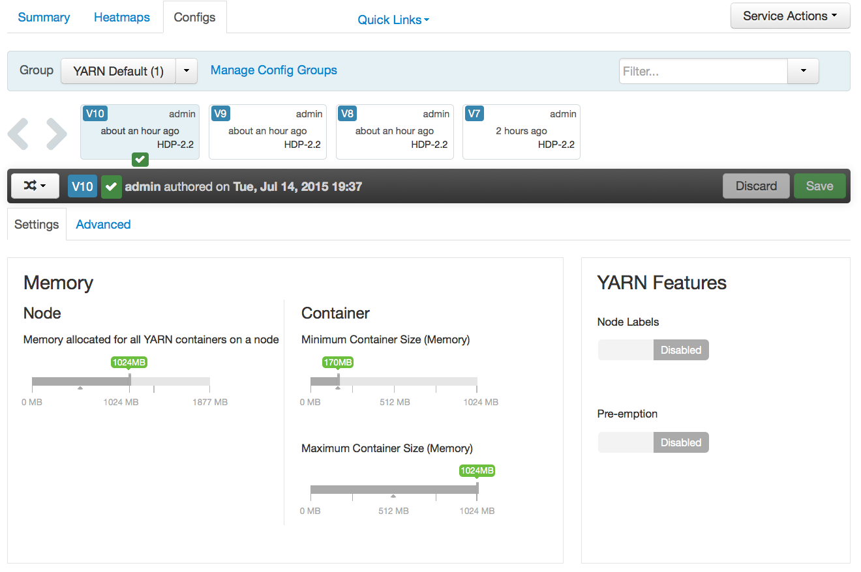
Layout and Grouping
Subtabs
Groups
Groups
New
Controls
New
Controls

Slide 75
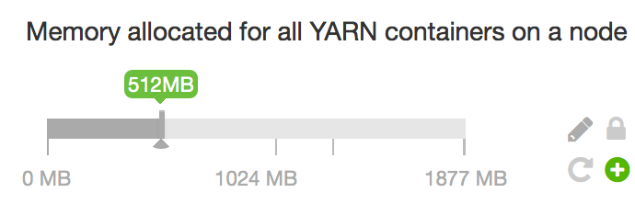
UI Controls
Escape
Hatch
Recommended
Value
Recommended
Bounds
Set
Recommended

Slide 76
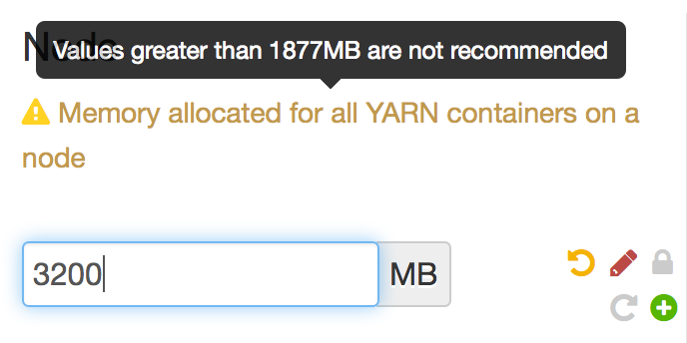
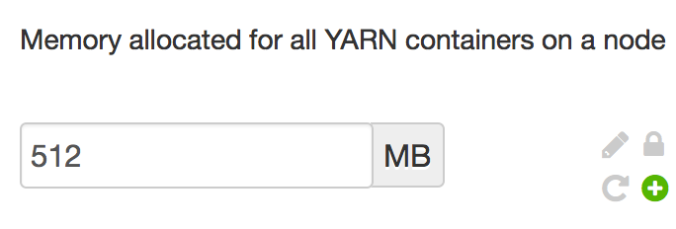
Control “Escape Hatch”

Slide 77
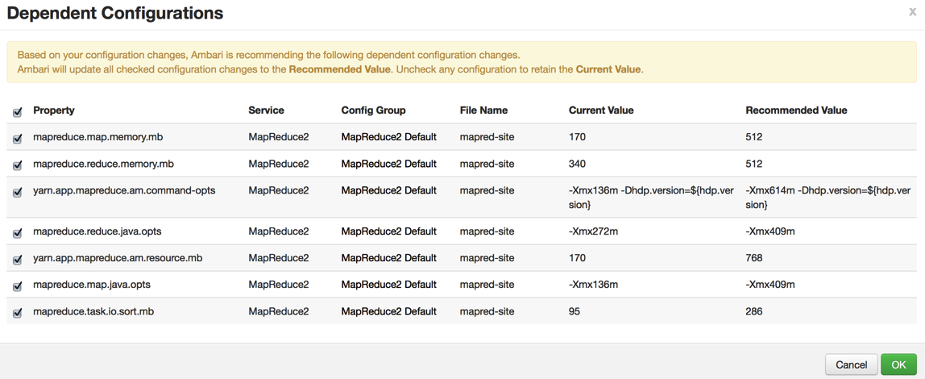
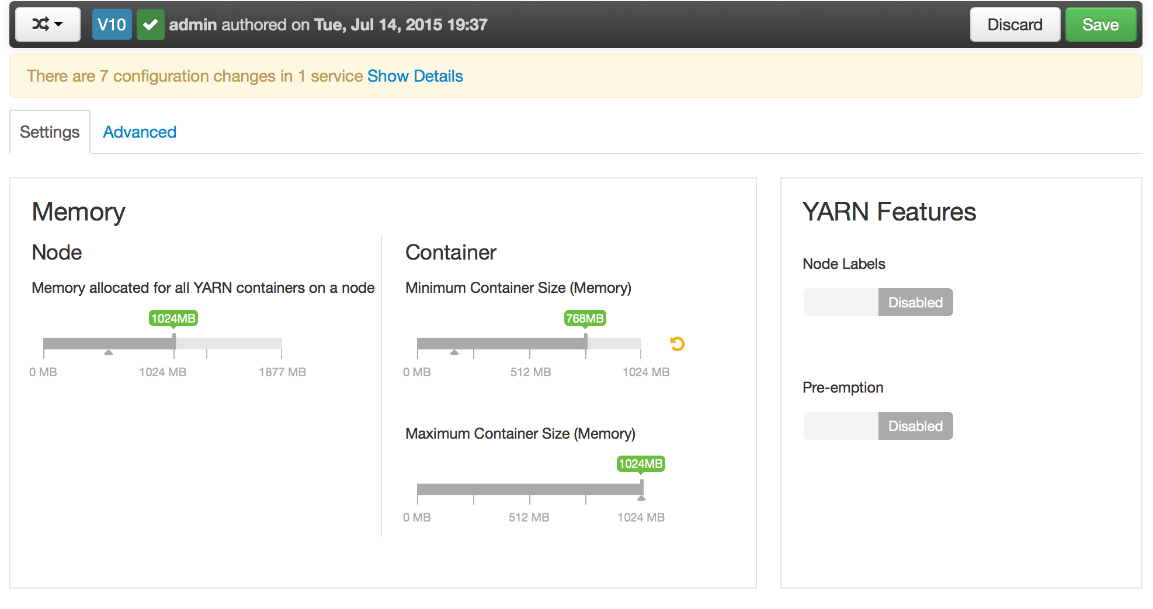
Dependency Checking

Slide 78
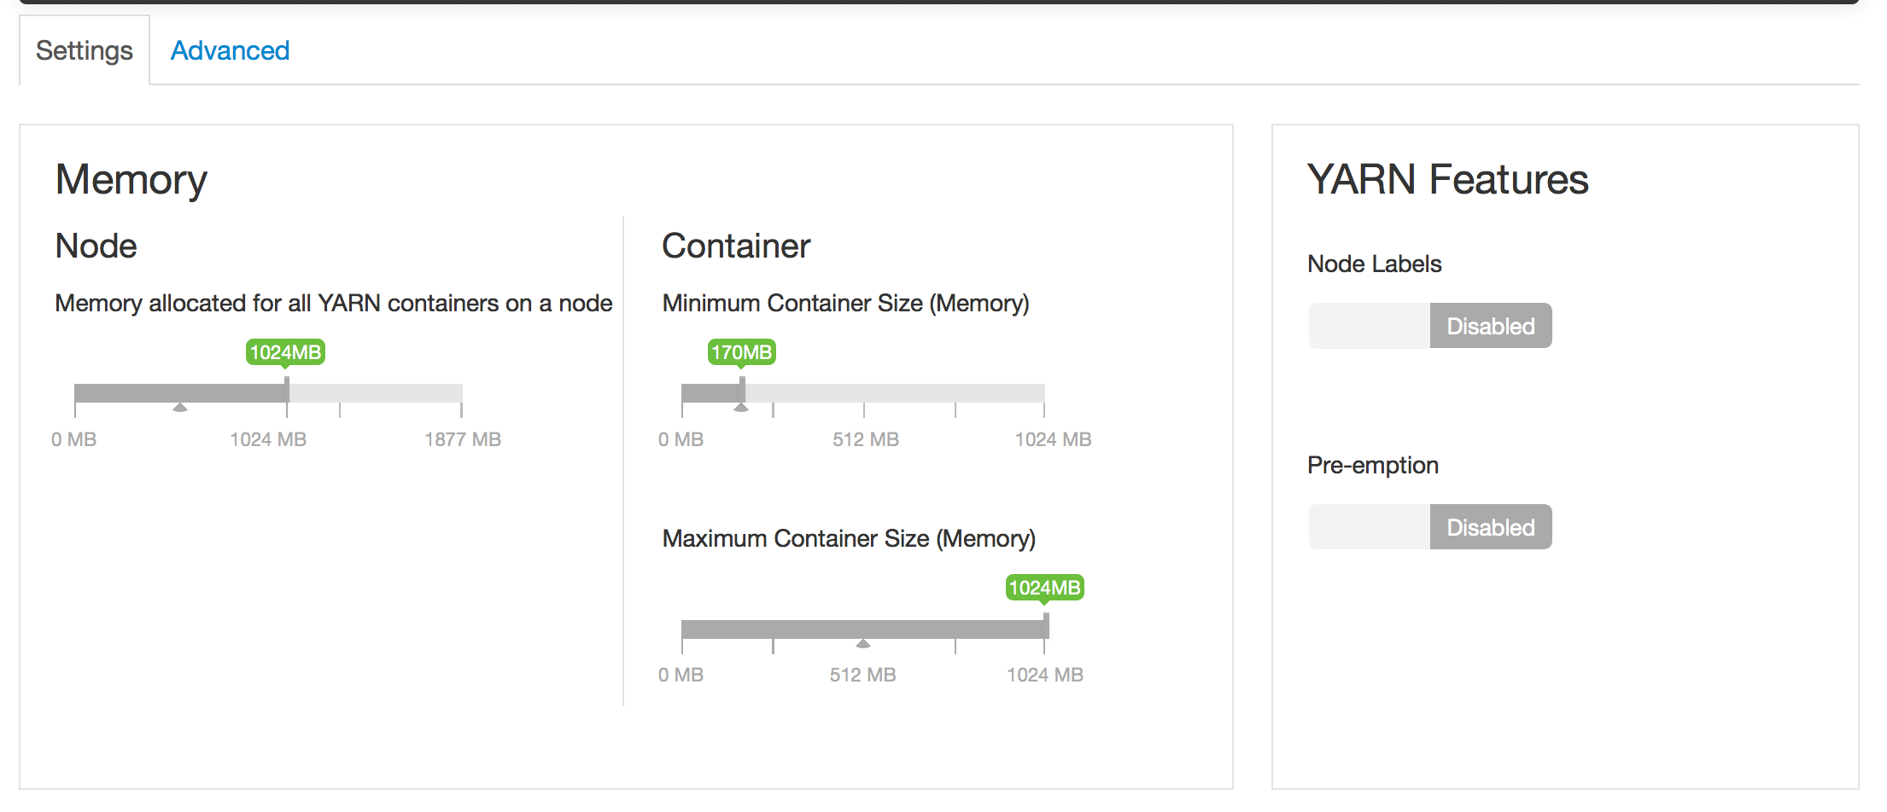
Driven By Stack Definition: Themes

Slide 79
Tabs
Tab1
Tab2

Slide 80
Sections
Section1
Section2

Slide 81
SubSections
SubSection1
SubSection2
SubSection1

Slide 82
UI Controls and Placement
Control + Placement
Control + Placement
Control + Placement
Control + Placement
Control + Placement

Slide 83
Ambari Views

Slide 84
Ambari Views Framework
Developers can extend the Ambari Web interface
Views expose custom UI features for Hadoop Services
Ambari Admins can entitle Views to Ambari Web users
Entitlements framework for controlling access to Views

Slide 85
Views Framework vs. Views
Views
Built by Hortonworks, Community, Partners
Views Framework
Core to Ambari

Slide 86
Views Framework vs. Views
Views
Built by Hortonworks, Community, Partners
Views Framework
Core to Ambari

Slide 87
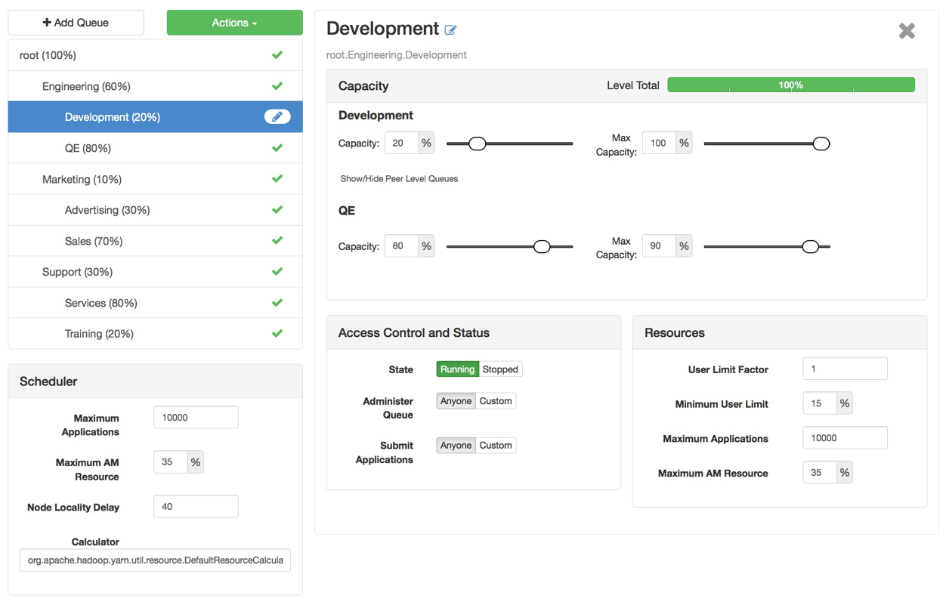
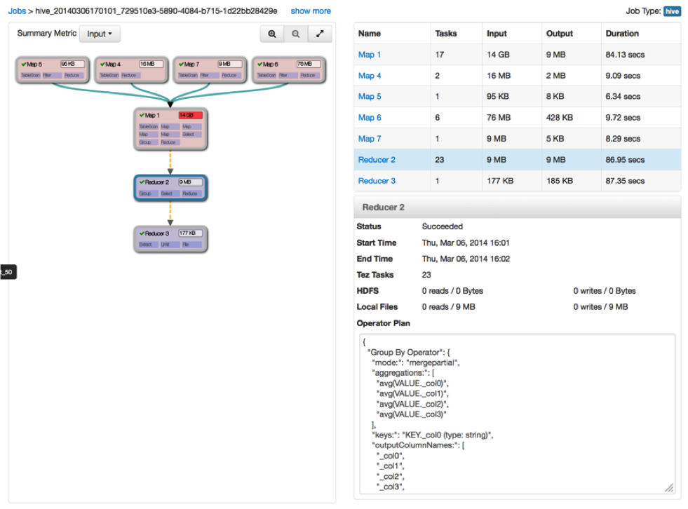
Example Views
Capacity Scheduler
“Queue Manager” View
Tez
“Jobs” View

Slide 88
View Components
Serve client-side assets (such as HTML + JavaScript)
Expose server-side resources (such as REST endpoints)
AMBARI WEB
AMBARI SERVER
VIEW
Client-side assets
(.js, html)
VIEW
Server-side resources
(java)
Hadoop and other systems
{rest}

Slide 89
View Delivery
Develop the View (just like you would for a Web App)
Package as a View (basically a WAR)
Deploy the View into Ambari
Ambari Admins create + configuration view instance(s) and give access to users + groups
Develop
Package
Deploy
Create Instance(s)

Slide 90
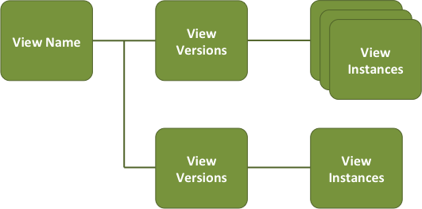
Versions and Instances
Deploy multiple versions and create multiple instances of a view
Manage accessibility and usage

Slide 91


Choice of Deployment Model
For Hadoop Operators:
Deploy Views in an Ambari Server that is managing a Hadoop cluster
For Data Workers:
Run Views in a “standalone” Ambari Server
Operators manage the cluster, may have Views deployed
Ambari
Server
HADOOP
Store & Process
Data Workers use the cluster and use a “standalone” Ambari Server for Views
Ambari
Server

Slide 92
Where Can I Learn More about Views?
https://cwiki.apache.org/confluence/display/AMBARI/Views
https://github.com/apache/ambari/blob/trunk/ambari-views/docs/index.md
https://github.com/apache/ambari/tree/trunk/ambari-views/examples
https://github.com/apache/ambari/tree/trunk/contrib/views

Slide 93
What’s New and Next

Slide 94
What’s New in Ambari 2.4 and Ambari 2.5
AUGUST
Core Features
Security Features
Add/Remove Journal Nodes (AMBARI-7748)
Service Auto-Start (AMBARI-2330)
Configuration Change Communication(AMBARI-19572)
HDFS TopN User & Operation Visualization (AMBARI-19320)
Download All Client Configurations(AMBARI-19275)
Built-In SNMP MIB (AMBARI-19257)
DB Inconsistency Self-Healing(AMBARI-18990)
Log Search TP Update(AMBARI-18817)
Ignore Host Pre-Check when Adding a Host (AMBARI-18817)
Operational Audit Logging (AMBARI-15241)
Role-Based Access Control (AMBARI-13977)
Automated Setup of Ambari Kerberos (AMBARI-15561)
Automated Setup of Ambari Proxy User (AMBARI-15561)
Customizable Host Reg. SSH Port (AMBARI-13450)
Views Framework Features
View URLs (AMBARI-15821), View Refresh (AMBARI-15682)
Inherit Cluster Permissions (AMBARI-16177)
Remote Cluster Registration (AMBARI-16274)

Slide 95
What’s Next
Modular Deployment of Services & Components
Configuration Management: Allow for configuration changes without a service restart
Configuration changes applied using rolling restart of masters
Spark integration with AMS
Support Amazon AWS KMS for storing master keys of Ranger KMS

Slide 96
Learn More About Apache Ambari
Resource | Location
Apache Ambari Project Page | http://ambari.apache.org
Ambari Project Wiki | https://cwiki.apache.org/confluence/display/AMBARI
Ambari Project JIRA | https://issues.apache.org/jira/browse/AMBARI
Stacks | https://cwiki.apache.org/confluence/pages/viewpage.action?pageId=38571133
Blueprints | https://cwiki.apache.org/confluence/display/AMBARI/Blueprints
Views | https://cwiki.apache.org/confluence/display/AMBARI/Views

Slide 97
Thank You

